Slide 1
Perkins V Consortium B
WORK-BASED LEARNING (WBL) STRATEGIC PLAN OVERVIEW
NORTHERN NEW MEXICO

Slide 2
project partners and funders
LANL Foundation
The Strengthening Career and Technical Education for the 21st Century Act (Perkins V) NM Region B Consortium Pooled Grant Funds
Institute for American Indian Arts
Northern New Mexico College
Santa Fe Community College (Fiscal Agent)
UNM – Los Alamos
UNM – Taos
Funds supported hiring consultants from Thomas P. Miller and Associates.

Slide 3
the strategic planning process
Our planning process took place from August 2020 to November 2020.
STEP 1 : Document Review and Environmental Scan
STEP 2 : Interviews and Stakeholder Input Sessions (Focus Groups)
STEP 3 : Stakeholder Survey
STEP 4 : Consortium Roundtable

Slide 4
stakeholders engaged in the strategic planning process
Private businesses
Tribal corporations or businesses
Post-secondary institutions
Secondary institutions
Government (state, county, or local)
Workforce or economic development organizations
Tribal governments
Labor organizations
Community-based organizations/nonprofits

Slide 5
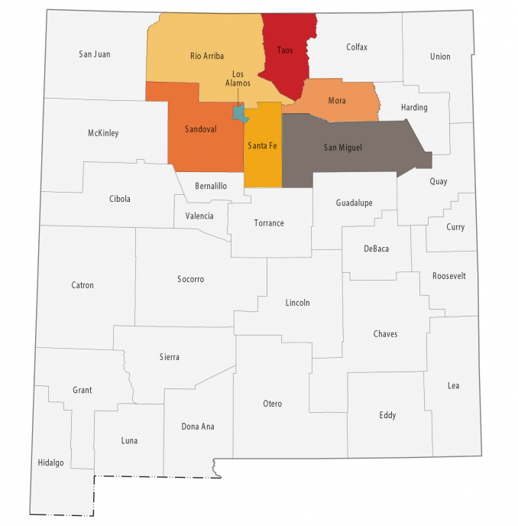
counties included in the plan
• Los Alamos
• Mora
• Rio Arriba
• San Miguel
• Santa Fe
• Taos
• Sandoval

Slide 6
KEY FINDINGS: work-based learning (WBL) critical elements
Registered Apprenticeship and Industry Recognized Apprenticeship Programs
Pre-Apprenticeship Programs
Internship Programs
Paid Work Study
Mentorships

Slide 7
KEY FINDINGS: stakeholder engagement opportunities
APPRENTICESHIP AND PRE-APPRENTICESHIP PROGRAMS
Stakeholders recognized the need for registered apprenticeship and pre-apprenticeship programs, particularly for youth.
INTERNSHIP AND MENTORSHIP
The expansion of opportunities at local nonprofits and community-based organizations as well as in rural communities and small businesses could also meet the need for WBL opportunities.
PAID WORK STUDY
Supporting and growing opportunities for paid work studies, so students do not have to choose between school and work. There is an opportunity to braid funding available through the Workforce Innovation and Opportunity Act (WIOA) and youth funding that is available via the local workforce development board.

Slide 8
KEY FINDINGS: stakeholder engagement opportunities
SUPPORT EMPLOYERS AND EDUCATIONAL INSTITUTIONS
Provide training and tool kits for employer and educational institutions to help effectively implement WBL.
EXPLORE ADDITIONAL OCCUPATIONAL PATHWAYS
Healthcare, information technology, construction, and energy-efficiency jobs, and the hospitality and tourism, machining, robotics, and additive manufacturing areas were suggested as pathways to expand WBL experiences.

Slide 9
STAKEHOLDER ENGAGEMENT: barriers and weaknesses
Not enough WBL programs and opportunities, especially paid work experience
Limited registered apprenticeship programs
Not enough WBL programs in high-demand career areas
Not enough WBL opportunities for youth
Lack of childcare, transportation, and other supports is a barrier for nontraditional, low-income individuals, and students of color
No centralized WBL coordination

Slide 10
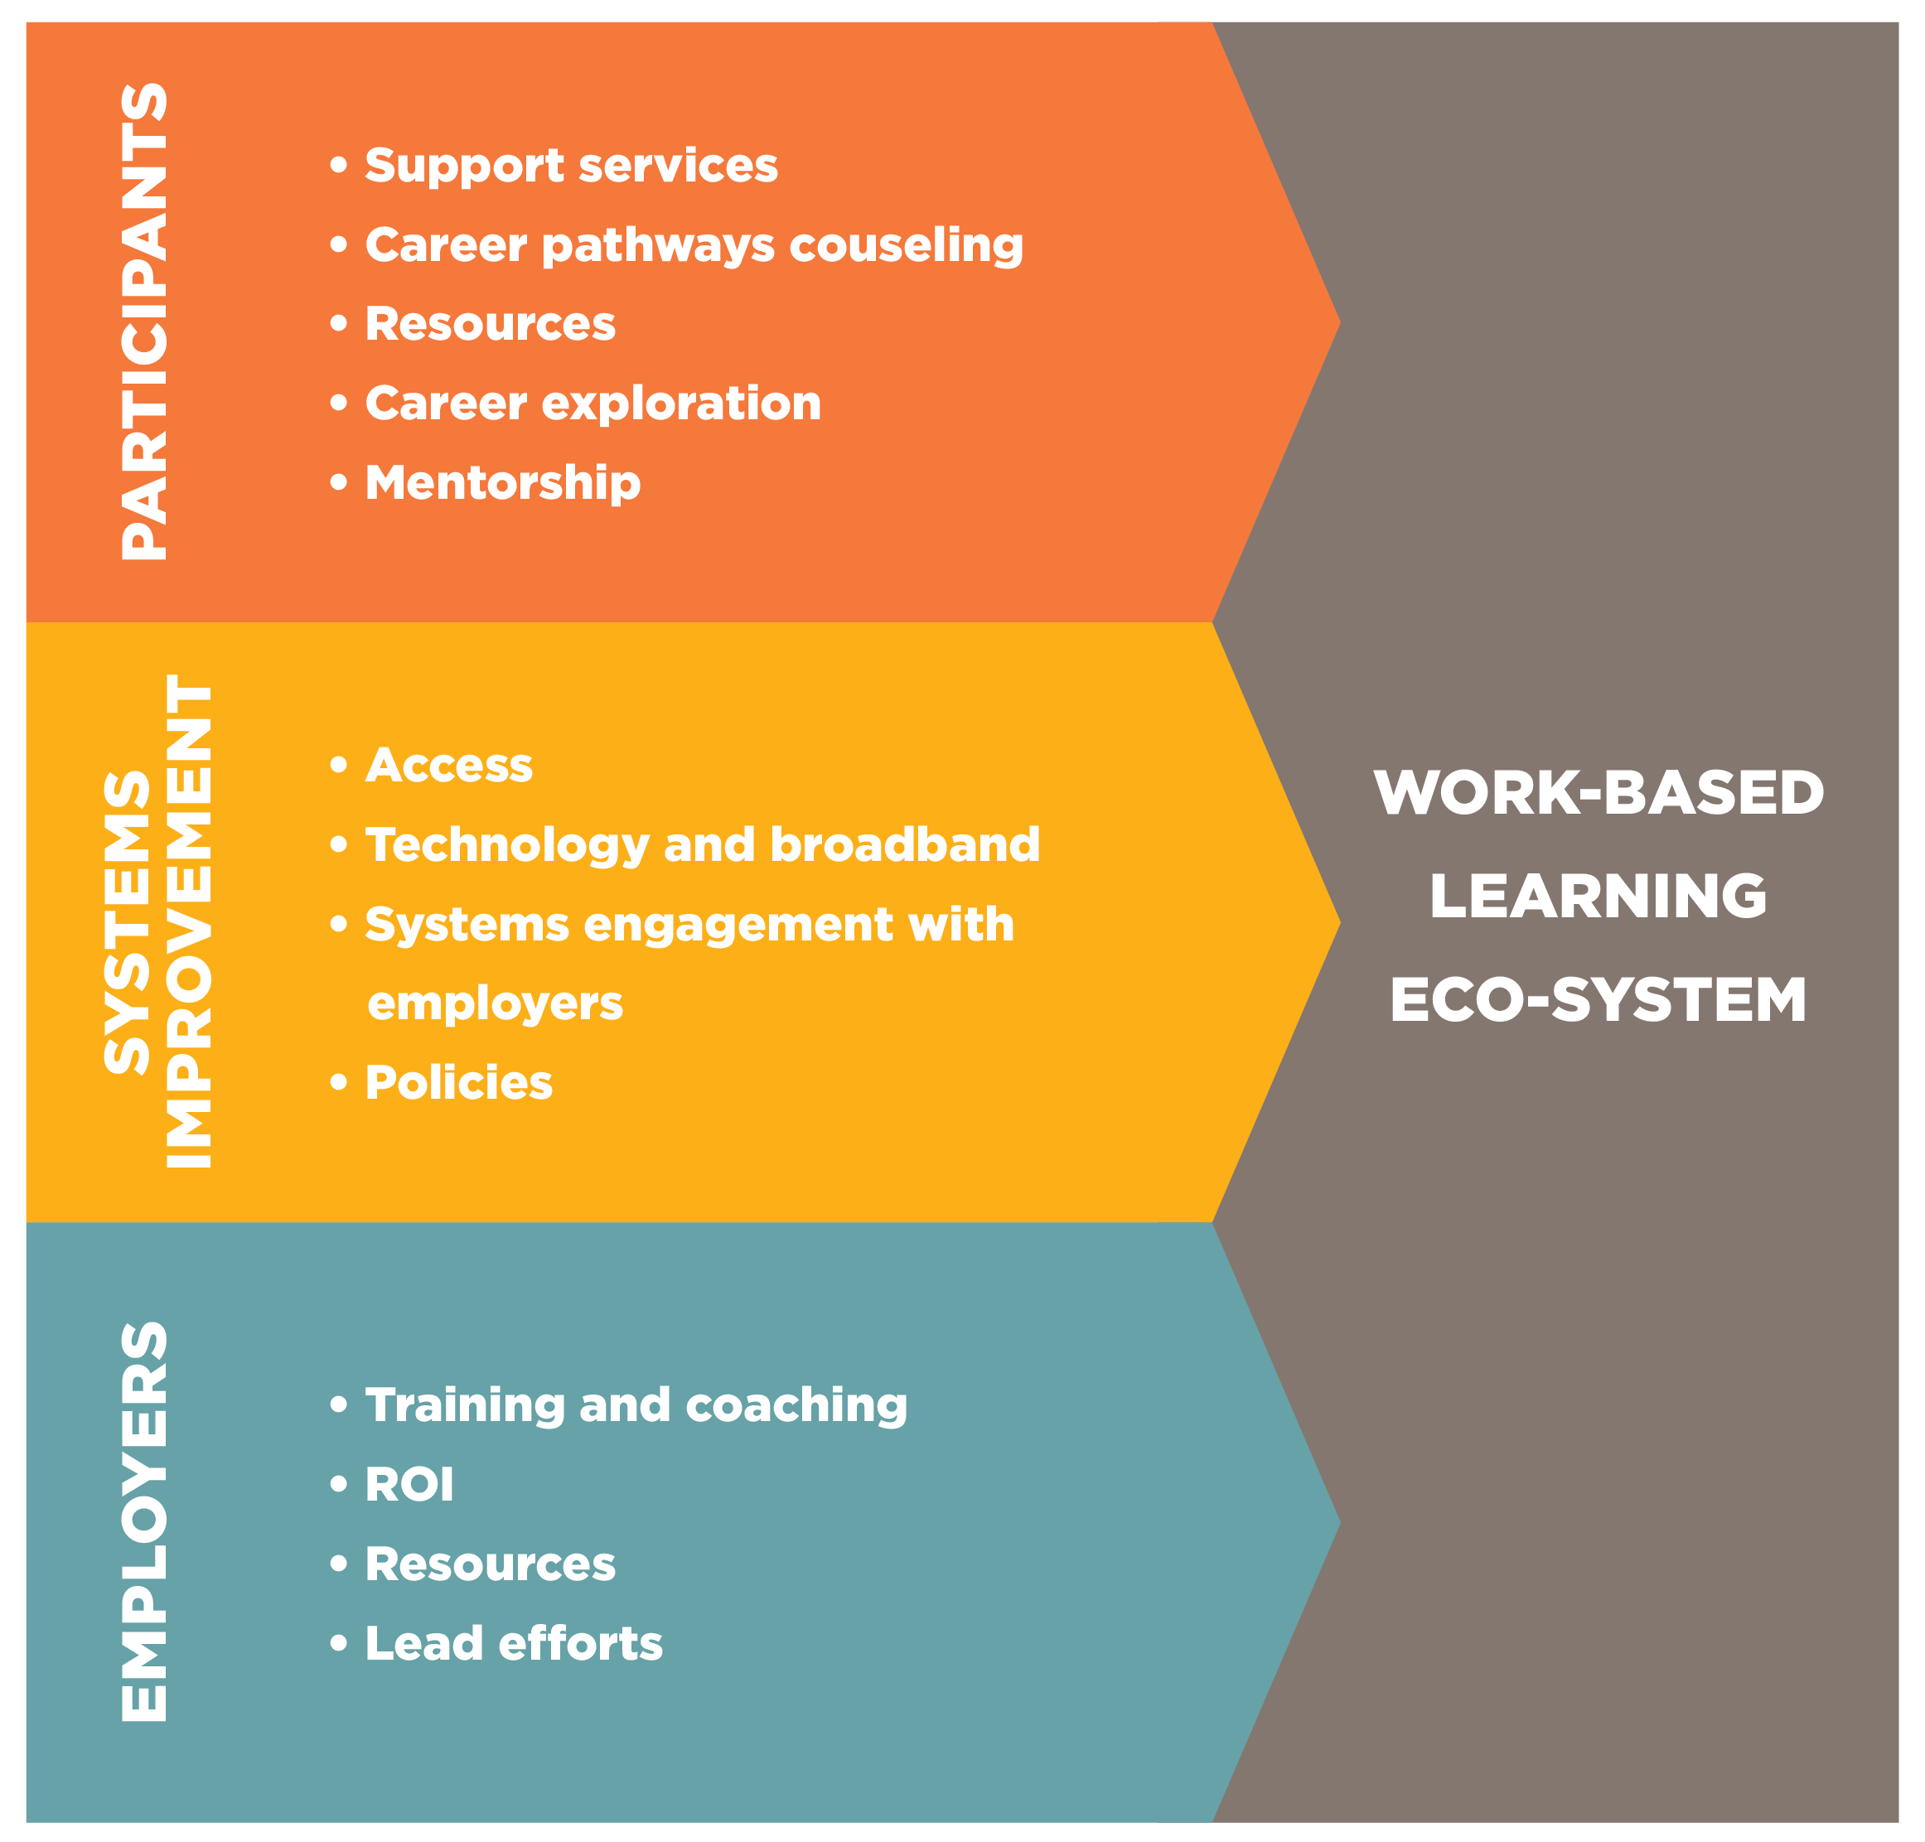
WBL barriers and weaknesses

Slide 11
recommendations and implementation
Centralized Leadership
Employer-Led Initiatives
Strengthened and Formalized Relationships Between Partners
Support Systems for Participants
Support Systems for Employers
Finding Solutions for Resource Alignment
Opportunities to Reach Underrepresented Populations

Slide 12
Northern New Mexico’s WBL Eco-system

Slide 13
examples of local WLB programs
Nuclear Operators Apprenticeship Program, Radiological Control Technician Bootcamp, Waste Processing Operator Bootcamp
Collaboration Partners: New Mexico Department of Workforce Solutions (NMDWS); Los Alamos National Laboratory (LANL); Northern New Mexico College (NNMC); University of New Mexico-Los Alamos (UNM-LA); and N3B-Los Alamos
Building and Construction Trades Registered Apprenticeship
Collaboration Partners: LANL, New Mexico Building and Construction Trades Council (NMBCTC) and Taos High School
PILAS Internship Program
Collaboration Partners: Santa Fe Community College, Santa Fe Community College Foundation, Los Alamos National Security (LANS) and LANL
X3 Internship Program
Collaboration Partners: Future Focused Education and Multiple Employers/Hosts

Slide 14
implementation outputs and suggested activities

Slide 15
OUTPUT 1: hire new regional WBL coordinator/manager
SUGGESTED ACTIVITIES:
Engage the WBL Eco-system’s key leadership to develop plans for centralized coordination of WBL efforts in northern New Mexico.
WBL Eco-system leadership forms and engages an employer-led advisory group to work with the regional coordinator in an advisory role.
WBL Coordinator works to ensure WBL programs’ alignment with labor market demand and new/emerging occupations.
WBL Coordinator works with the employer advisory group to coordinate systems and communication for marketing and outreach.
WBL Coordinator and the employer advisory group coordinate finding, securing, and braiding solutions for resource alignment.

Slide 16
OUTPUT 1 (cont.): hire new regional WBL coordinator/manager
SUGGESTED ACTIVITIES:
WBL Coordinator and the employer advisory group will engage with the Northern Area Local Workforce Development Board, the Department of Workforce Solutions, the Northern New Mexico Economic Development District, the pueblos, tribes, and nations of northern New Mexico, and other similar agencies to leverage funding and resources.
Coordinate with WBL partners to host an online portal to become a “one-stop shop” for all WBL opportunities. This portal can provide connections between employers/sponsors, participants, and education providers. The online portal could also provide a resource for additional information on WBL programs in the northern New Mexico region, provide answers to frequently asked questions, and connect users to support services and toolkits.

Slide 17
OUTPUT 2: increase number of students/participants engaged in WBL opportunities
SUGGESTED ACTIVITIES:
Coordinate pre-screening and referral activities through on-ramp programs that create pathways to careers, support service providers, and education providers.
Convene public and private partners to facilitate the building of a WBL candidate pipeline with an emphasis on supportive services.
Align paid work experiences with education opportunities.
Explore, scale, and/or replicate existing pipeline/job readiness training programs that prepare individuals via job-skill development, classroom, and hands-on job training.
Leverage existing resources, networks, and WBL Eco-system Partners to assist with recruitment and support services for individuals interested in and/or already participating in WBL experiences.
Prospect current employer partners for opportunities to develop/offer WBL opportunities to incumbent workers to enhance their skills and advance career pathway opportunities.

Slide 18
OUTPUT 3: increase employers WBL participation and available opportunities
SUGGESTED ACTIVITIES:
WBL Coordinator and the employer advisory group develop a business engagement strategy/plan.
Inventory and document current resources and incentives available to employers; recognizing gaps in services and supports for future development.
Formalize WBL structures and frameworks, particularly focusing on paid internships and registered apprenticeship.
Develop Return on Investment (ROI) model to help promote employer engagement in WBL.
Develop employer tool kit/handbook (including templates, frameworks, and documents) to assist employers in implementing and scaling WBL opportunities.
Develop mentorship handbooks, onboarding workshops, and other training resources for employers, mentors, and sponsors of WBL.
Expand outreach efforts to small- to medium-sized businesses and businesses located in rural areas to provide support and guidance on developing WBL opportunities for local citizens.

Slide 19
OUTPUT 4: increase registered apprenticeship programs (RAPS) opportunities
SUGGESTED ACTIVITIES:
Formalize the partnership between the WBL Eco-system and New Mexico’s State Office of Apprenticeship.
In partnership with the Office of Apprenticeship, continue to research and document organizations that offer group-sponsored model RAPs. Group-sponsored apprenticeships can be expanded and replicated to serve small- to medium-sized businesses that do not have the internal capacity to support developing RAPs.
Partner with the State Office of Apprenticeship to increase opportunities with employers already approved to offer RAPs.
Continue to explore emerging industries and industries in need of new training/retraining of incumbent workers for RAP program development.
Explore nontraditional models for RAPs, including competency-based, hybrid, short-term, and industry-recognized apprenticeship programs.

Slide 20
OUTPUT 5: increase partners engagement
SUGGESTED ACTIVITIES:
Inventory and document current resources and supportive services available to providers and partners.
Formalize relationships between partners, employers, and educational providers via MOUs, articulation agreements, etc.
Provide training and resources to the front-line/case management staff of partners and providers on WBL opportunities in the region.
Document a formalized referral process for potential WBL participants to connect WBL programs and education providers.
Engage in long-term planning to address systemic inequities and barriers to workforce and education resources, ensuring equitable access to WBL opportunities.
Explore short- and long-term solutions for increasing access through technology and broadband.

Slide 21
Questions / Discussion

